Slide 1
Final Project Breakdown

Slide 2
Savings Calculator Breakdown
So, this project, although doable with the skills you’ve been taught, was never meant to be very easy
It brings together most of the principles from today and adds to that the complexity of building a larger codebase
This presentation will run you through how I would have created this project myself
Disclaimer: there are a million different ways to do every task in programming. This is my way of doing it but there are definitely other good ways as well.

Slide 3
First Step: Understanding the brief
Whenever presented with a ”spec” or specification, we must break it down into its basic components to give us the best chance of success
So let’s run through each point in the spec and see what we learn
Project Guidelines:
Function 1: Total Savings Calculator
Inputs: Age, Monthly savings amount
Output: Print Total amount saved at age 60 (at 5%, 7% and 10% yield)
Function 2: Monthly Savings Calculator
Inputs: Age, Total Saving Goal
Output: Print Monthly savings amount (at 5%, 7% and 10% yield)
The two functions should be called by a “master” function that allows the user to choose what they want to calculate

Slide 4
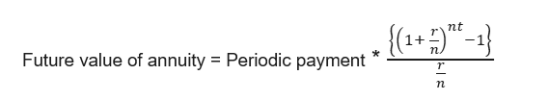
The Important Equation
This equation allows us to use algebra to solve for the values we care about
The variables in questions are:
r – rate of yield/interest rate
n – rate of investments per cycle (12 for monthly)
t – number of cycles total (years)
The key here are MATHEMATIC OPERATORS

Slide 5
The Important Equation (In Code)
Writing this equation is relatively trivial
Recall the following skills:
1. using functions
2. The +,-,/ and ** operators
This function simply computes the algebraic portion of the equation
We can use this to very simply compute the values later on

Slide 6
Function 1: Total Savings Calculator
Inputs: Age, Monthly Savings Amount
Outputs: Total Savings at Age 60
Inputs and outputs means we need VARIABLES
We want to output Total Savings in Dollars, therefore we need to use the round function to keep it to 2 decimal places

Slide 7

Total Savings Calc (in code)
Firstly, we need the user to input their age and their intended monthly savings amount
We need to cast the values into ints to make sure we can use them in equations later on
Recall that the input function will return a string

Slide 8


Total Savings Calc (in code)
Once we get the inputs, we can use the values to calculate the total payment
We can then round these values into 2 decimals using the round functions

Slide 9
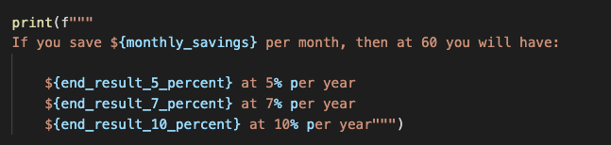
Total Savings Calc (in code)
Now we have everything we need, we just need to print the values out
We can use print statements and f strings here

Slide 10
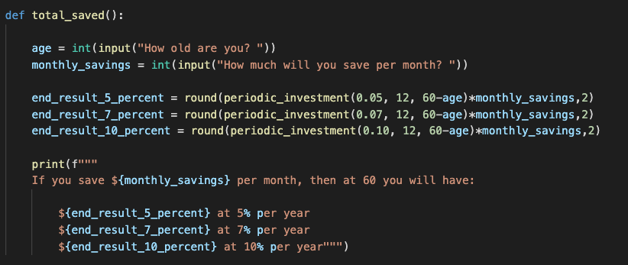
Total Savings Calc (final)
So now we can put this all together and we have a completed function!

Slide 11
Function 2: Monthly Savings Calculator
Inputs: Age, Total Savings Amount
Outputs: Monthly Saving required
Inputs and outputs means we need VARIABLES
We want to output Monthly Savings in Dollars, therefore we need to use the round function to keep it to 2 decimal places

Slide 12

Monthly Savings Calc (in code)
Firstly, we need the user to input their age and their end goal
We need to cast the values into ints to make sure we can use them in equations later on
Recall that the input function will return a string

Slide 13


Monthly Savings Calc (in code)
Once we get the inputs, we can use the values to calculate the monthly payment
We can then round these values into 2 decimals using the round functions

Slide 14
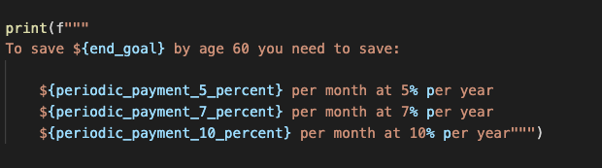
Monthly Savings Calc (in code)
Now we have everything we need, we just need to print the values out
We can use print statements and f strings here

Slide 15
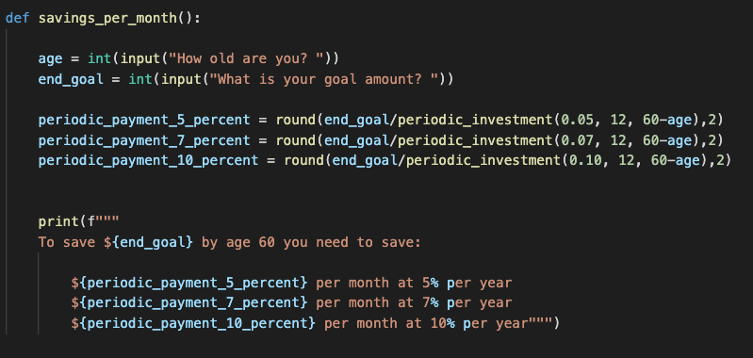
Monthly Savings Calc (final)
So now we can put this all together and we have a completed function!

Slide 16
What do we have left
The two functions should be called by a “master” function that allows the user to choose what they want to calculate
The key features are:
Input to ask the user for their choice
If/else to give the user choices
Function calls to use the 2 functions we created previously

Slide 17
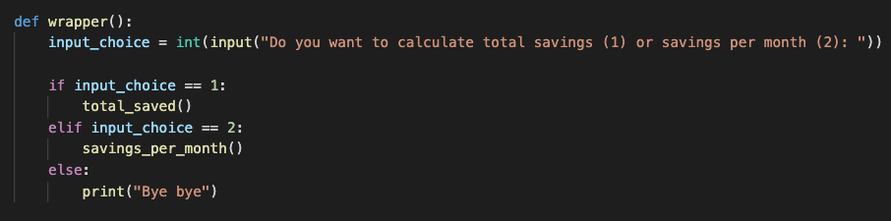
Wrapper function (in code)
As we see below, the flow is relatively simple
Ask for input
Use the if/else syntax to call different functions

Slide 18
How to run the function
Running the project is all that’s left now!
We can simply type wrapper() into the terminal and run it!

Slide 19
Final Project Link
https://github.com/siddbose97/pythonWorkshop/blob/master/savings_calculator.py
At this link you can find the final code for this project
As I mentioned earlier, if you wish to contact me for help or any questions please reach out at siddbose97@gmail.com

